Slide 1



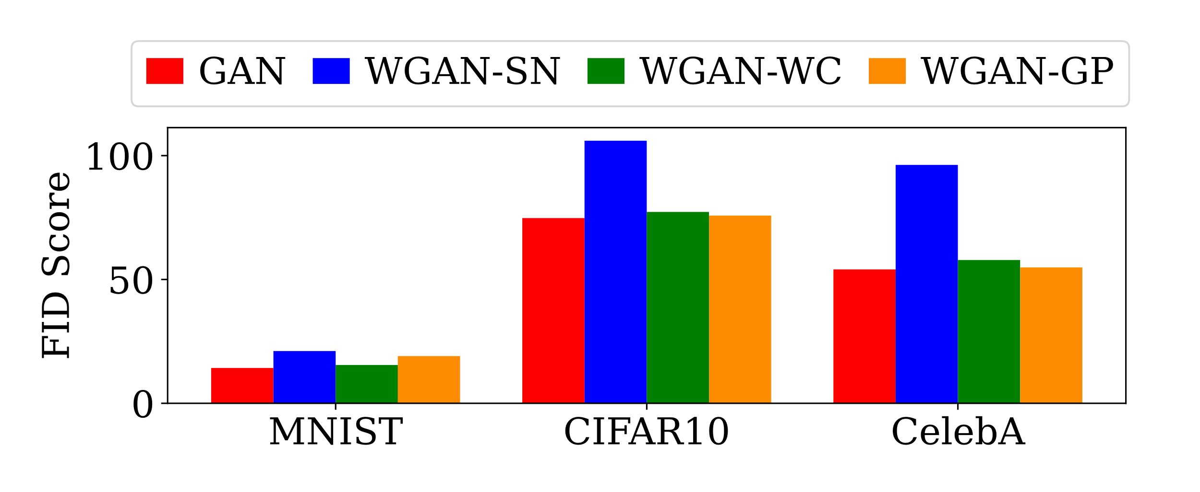
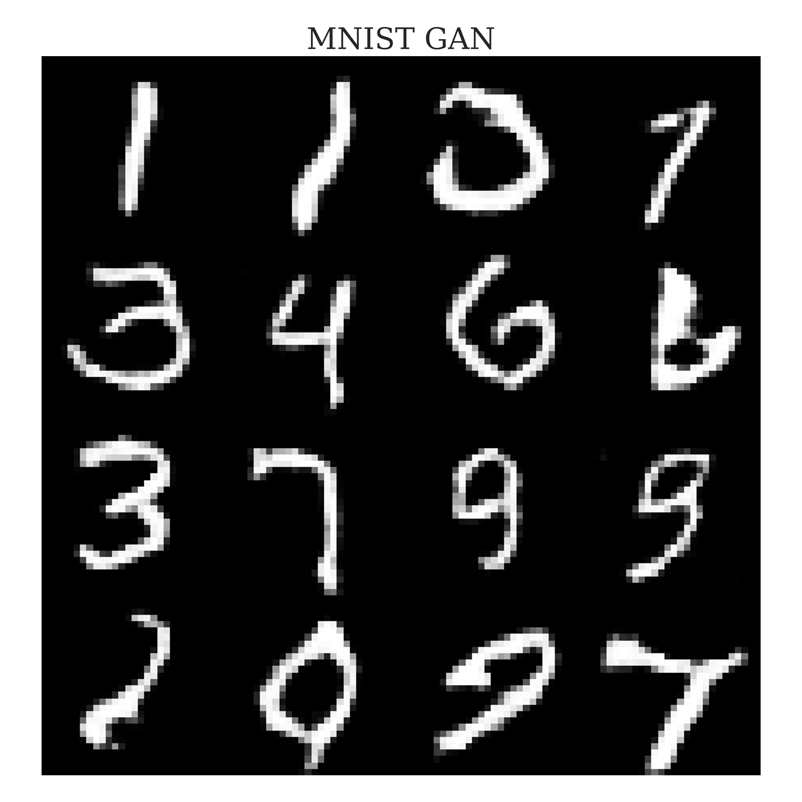
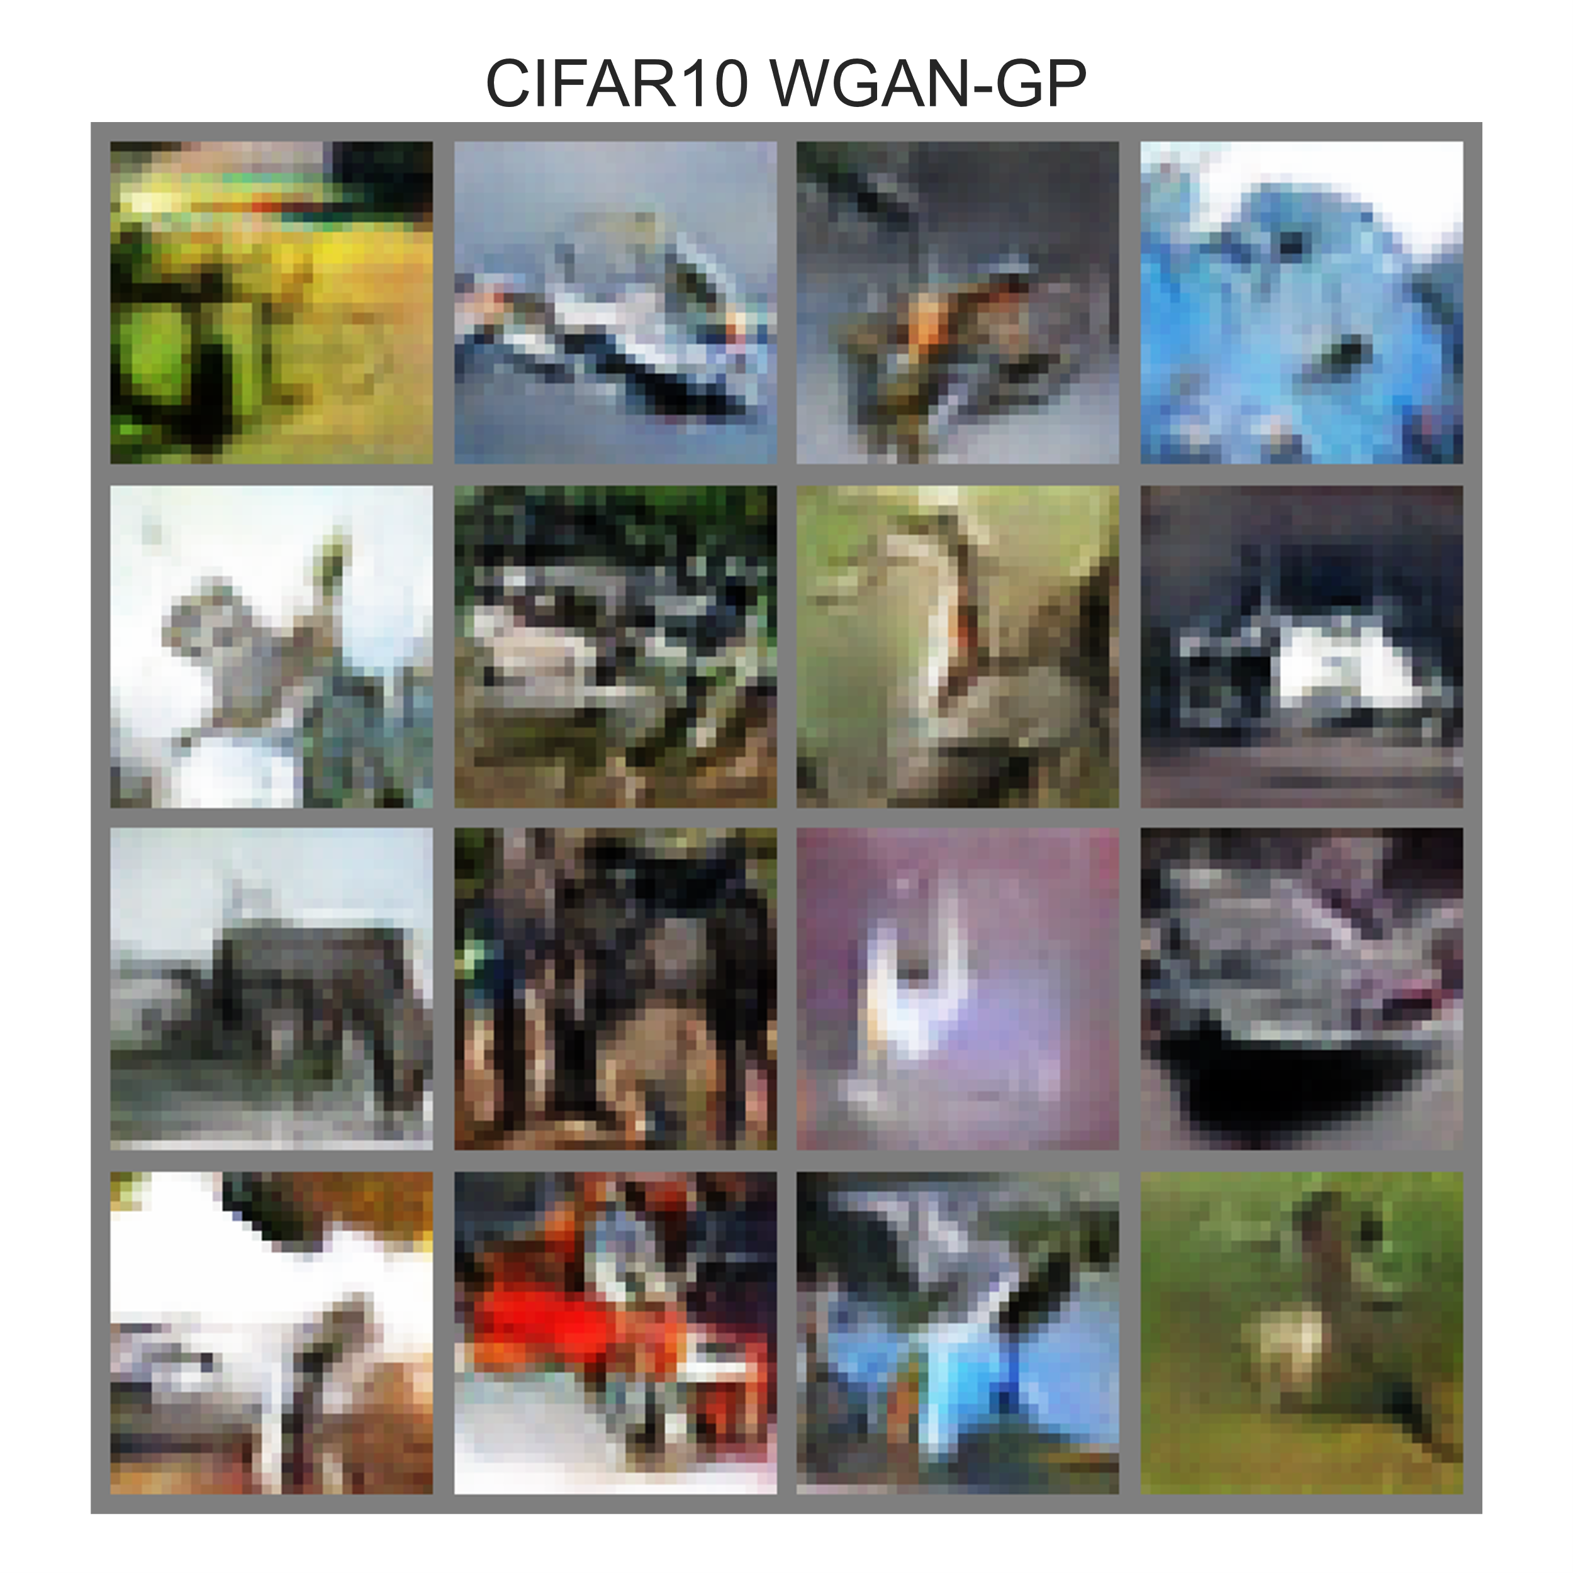
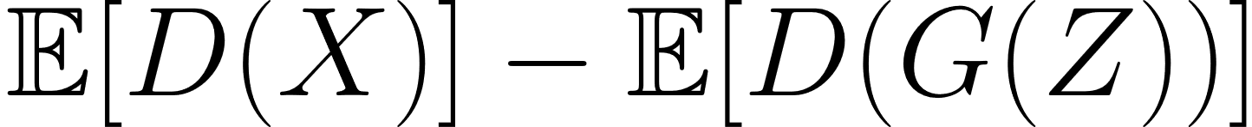
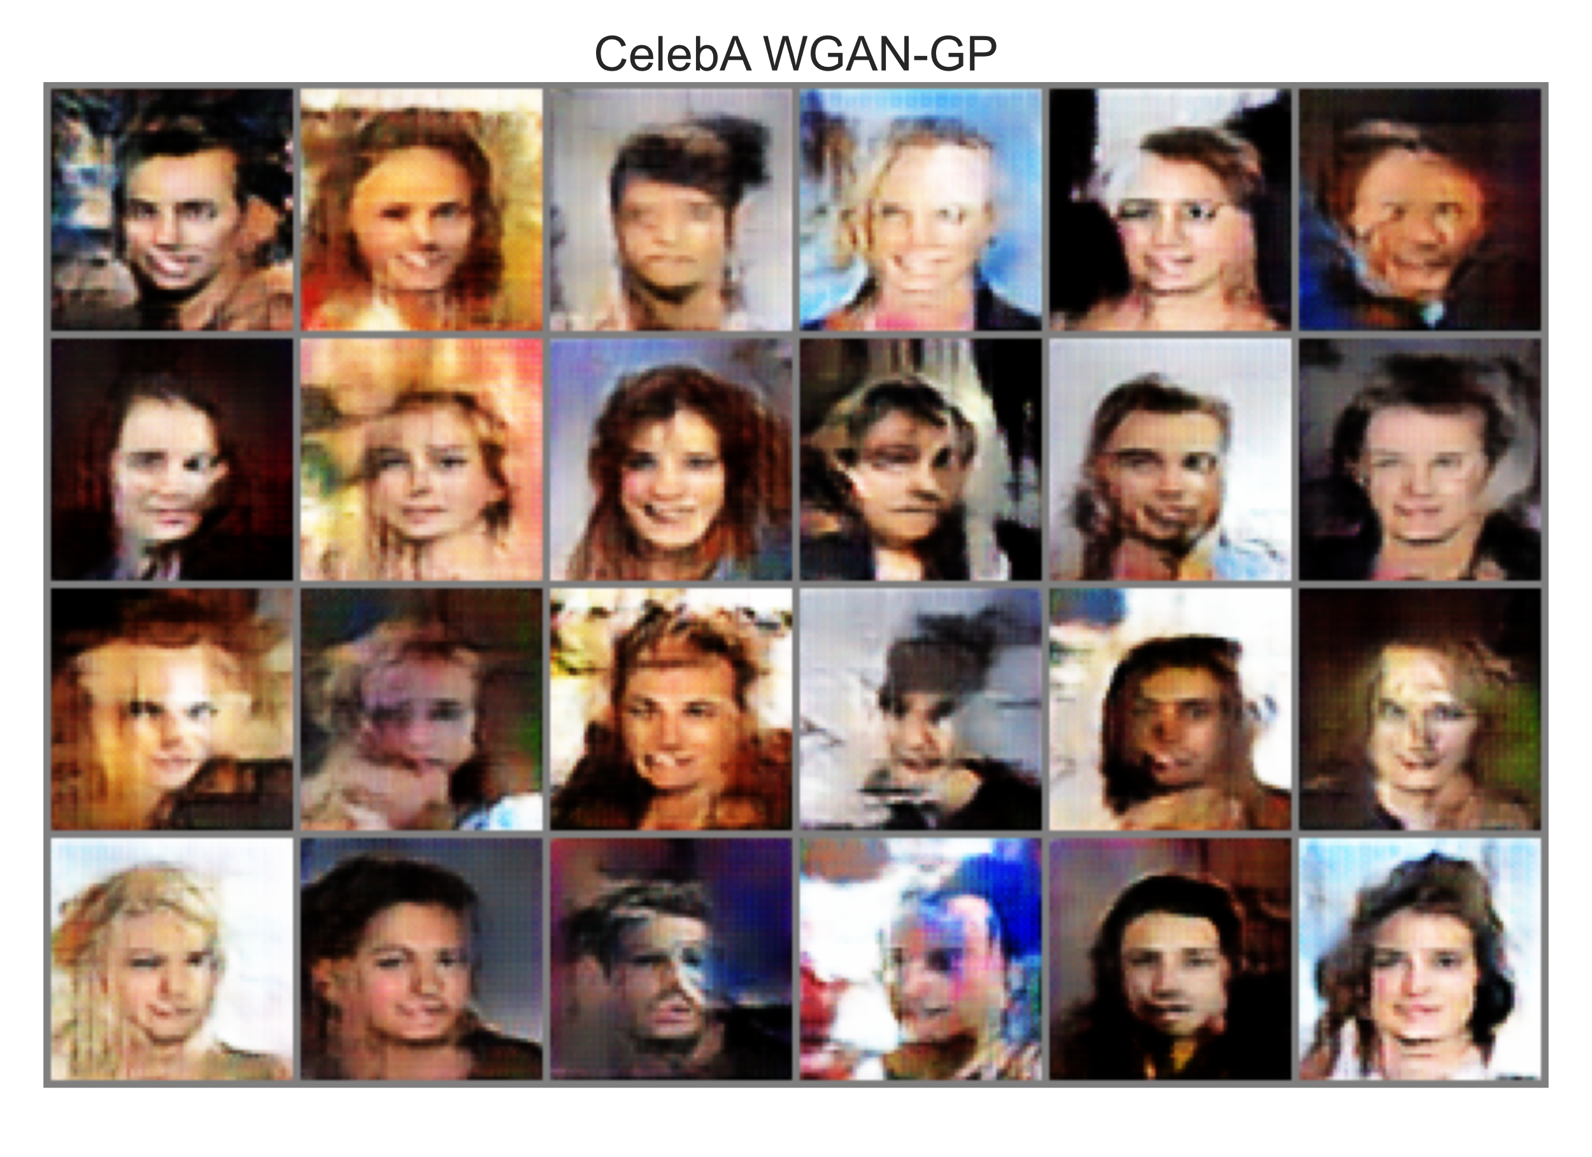
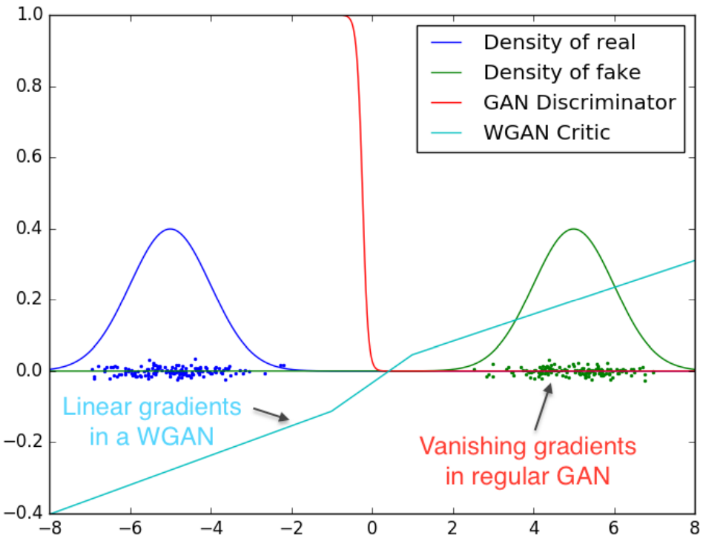
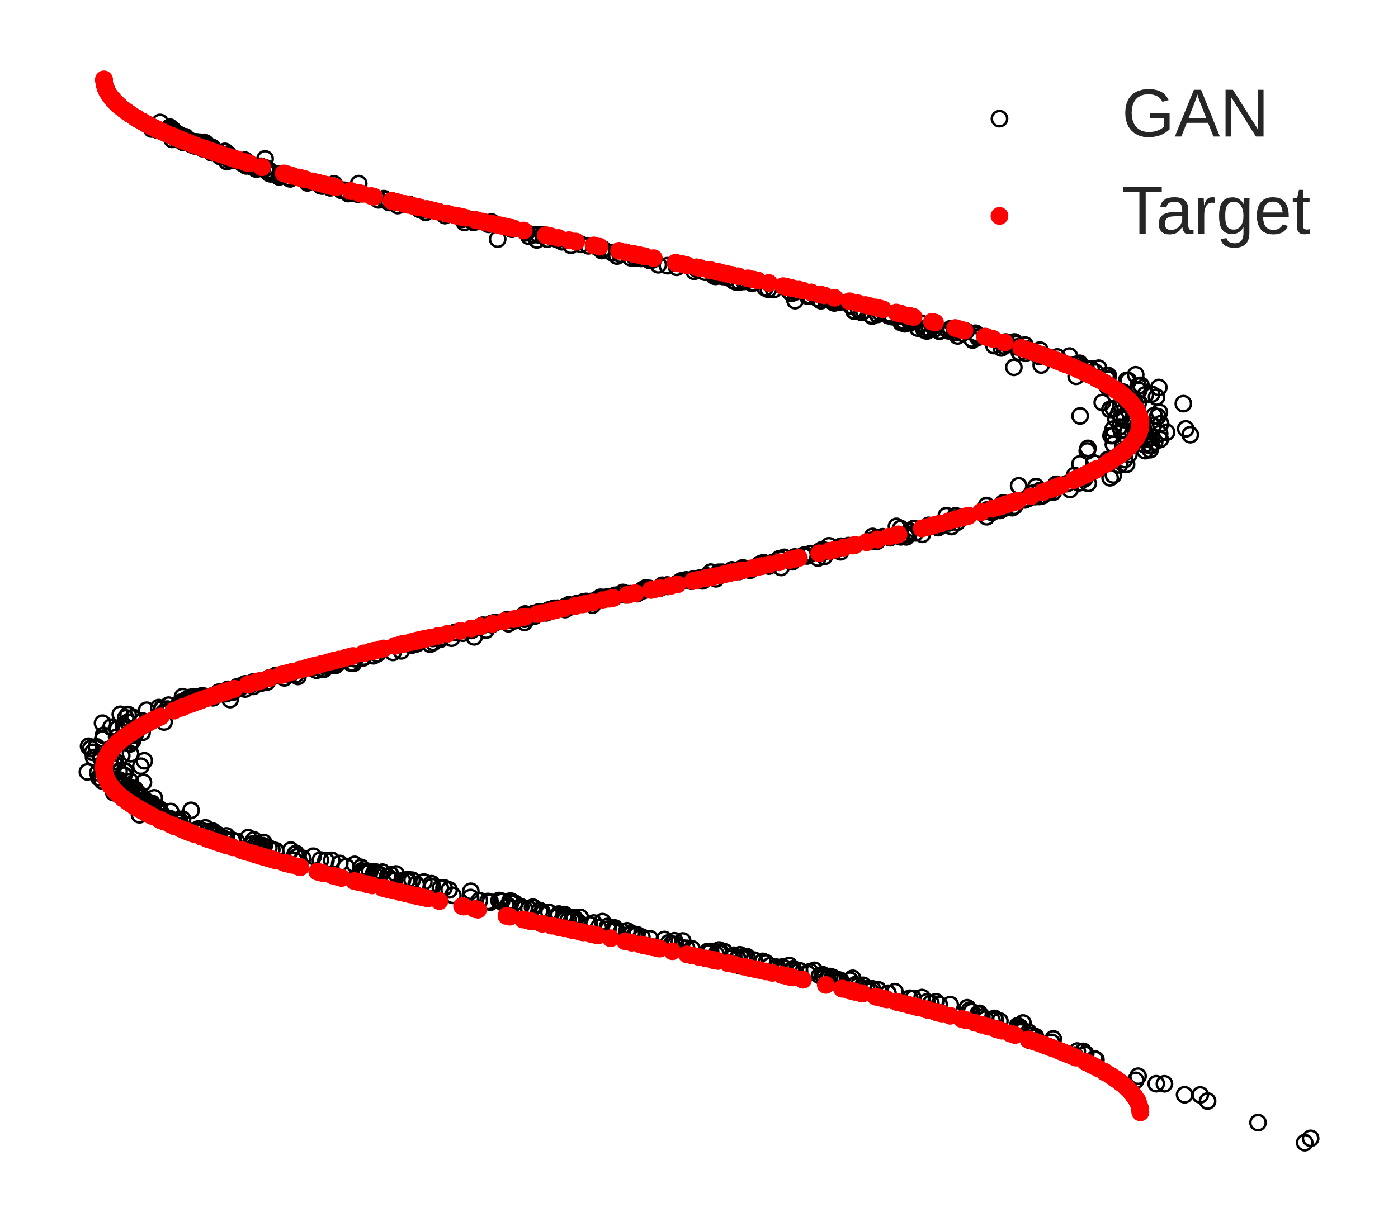
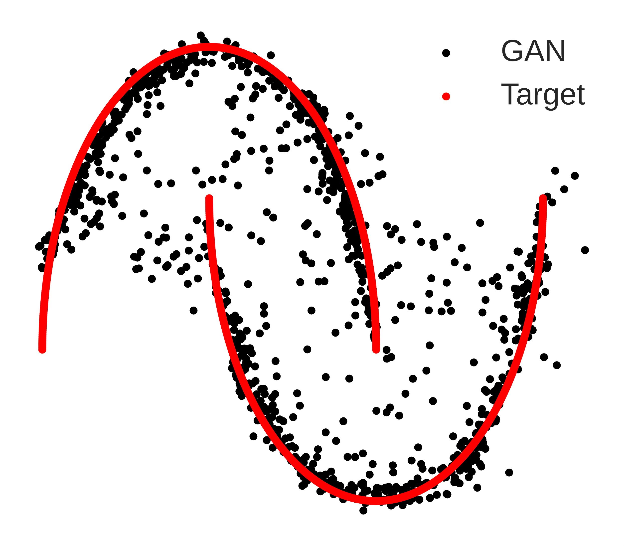
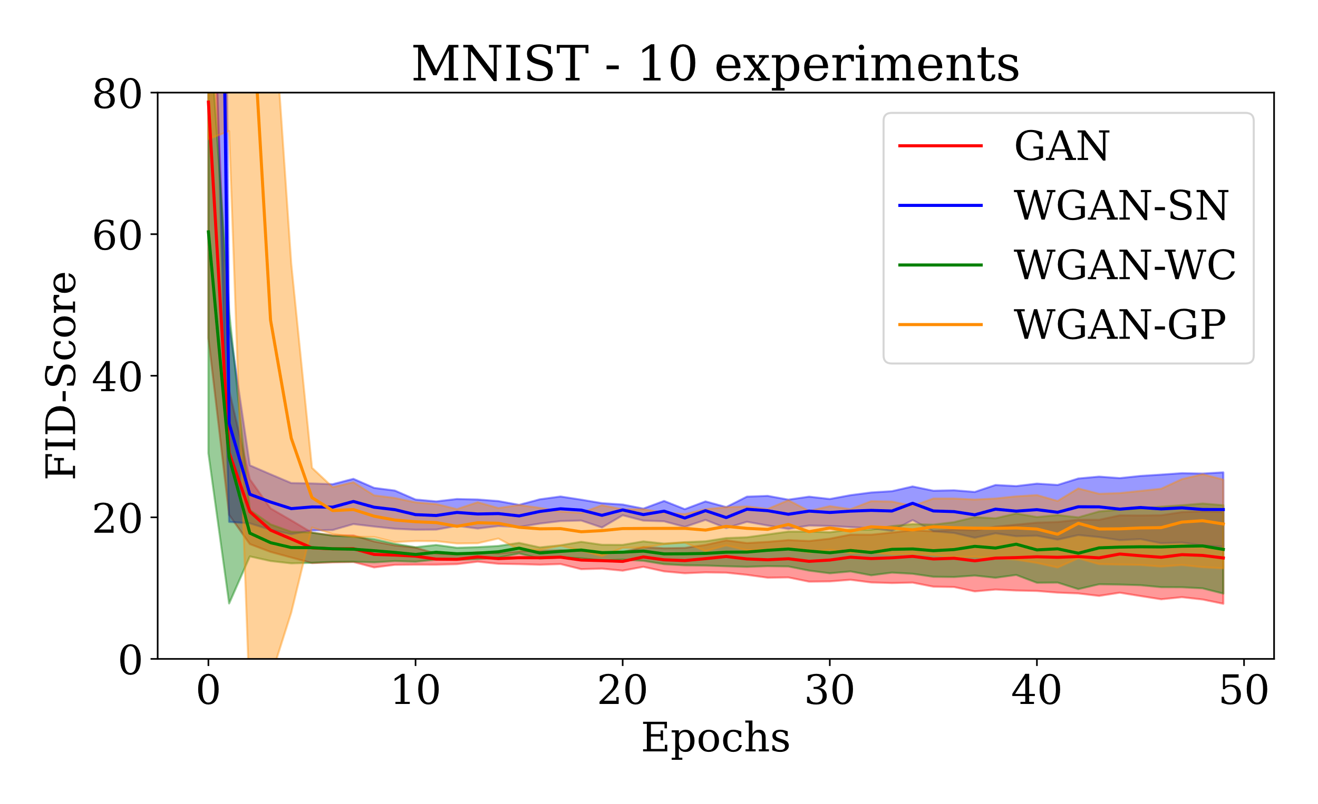
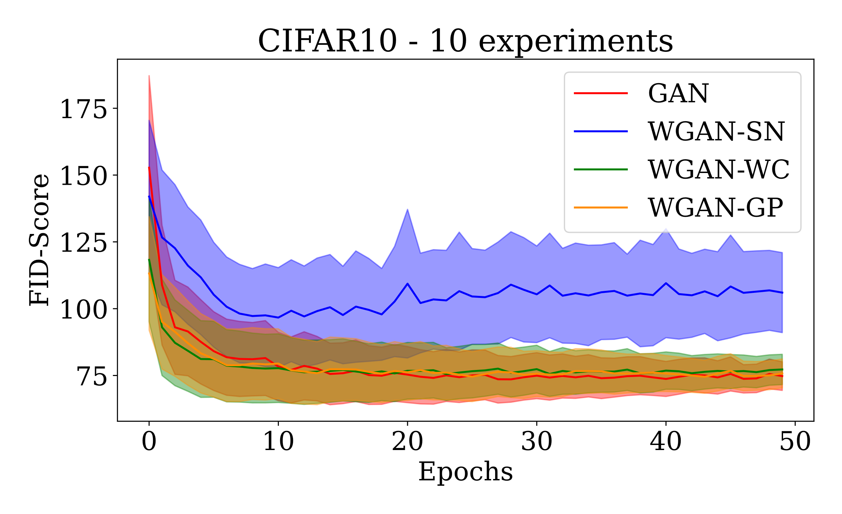
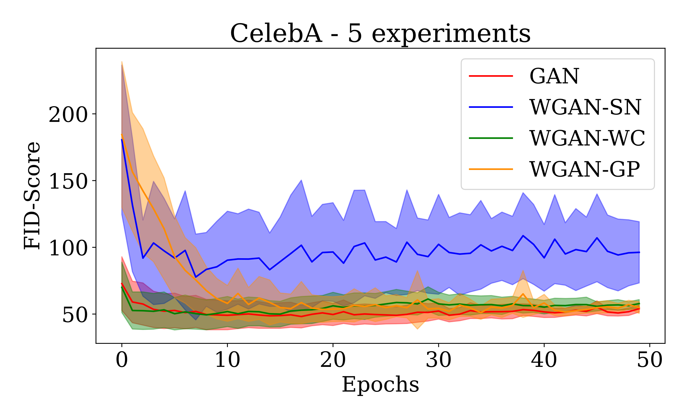
02456 Deep Learning
Wasserstein Generative Adversarial Network
Matias Bundgaard-Nielsen, s173981
Jens Christian Bang Gribsvad, s174477
Generative Adversarial Network (GAN)
Results
Theory
Gan loss [1]
WGAN loss [2]
Discriminator output: 0-1 for GAN, continuous for WGAN. Vanishing gradients are a problem in GAN.
Training is hard in GAN but more stable in WGAN
Lipschitz continuity must be enforced in WGAN. We use weight-clipping (WC)[2], spectral normalization (SN)[3], and gradient penalty (GP)[4].
Simple Distributions
Convergence
Same architecture leads to similar performance regardless of WGAN / GAN loss
Spectral normalization use layernorm instead of batchnorm leading to worse performance
Frechet Inception Distance (FID) [5]
FID is a measure that captures the similarity between generated images and real ones.
Images → Pre-trained Inception V3 model → use feature vectors to compute:
References
[1] Goodfellow & Pouget-Abadie, et. Al, (2014. Advances in Neural Information Processing Systems. 3. 10.1145/3422622.
[2] M. Arjovsky, S. Chintala, and L. Bottou. Wasserstein GAN. CoRR, abs/1701.07875, 2017.
[3] T. Miyato,et al. In International Conference on Learning Representations (ICLR), 2018.
[4] Ishaan Gulrajani, et. Al, 2017. In Proceedings of the 31st International Conference NIPS'17.
[5] Heusel,et. Al., (2017). Advances in Neural Information Processing Systems. 30. arXiv:1706.08500

